Slide 1
Class 2: Neural Network Basics
Andrew Parnell

Slide 2
Learning outcomes
Understand what neural networks are and how they create predictions.
Build a small neural network step by step.
Practice dot products, linear transforms, and activations by hand.
Prepare for coding NNs in the next session.

Slide 3
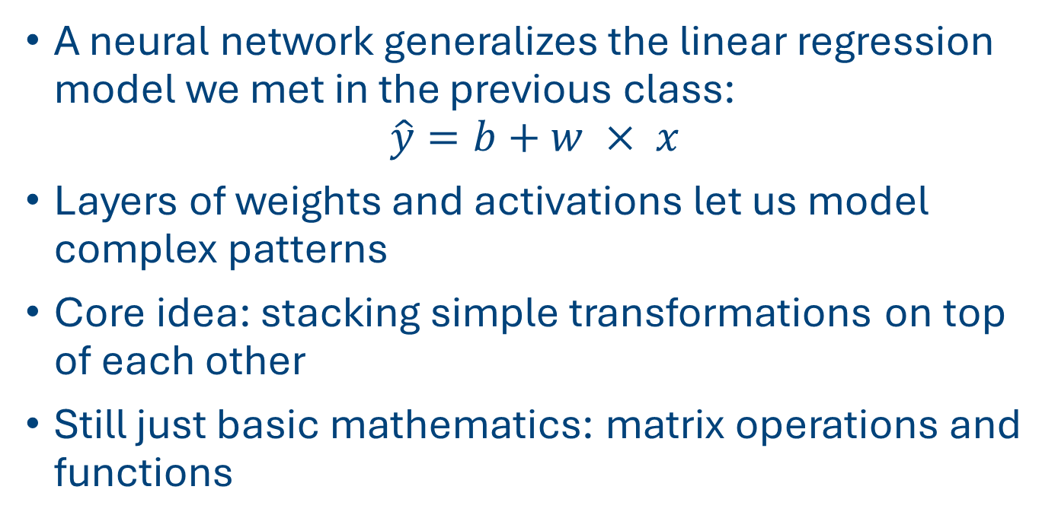
Foundations of Neural Networks (NNs)
A neural network generalizes the linear regression model we met in the previous class:
$$\hat{y}=b+w × x$$
Layers of weights and activations let us model complex patterns
Core idea: stacking simple transformations on top of each other
Still just basic mathematics: matrix operations and functions

Slide 4
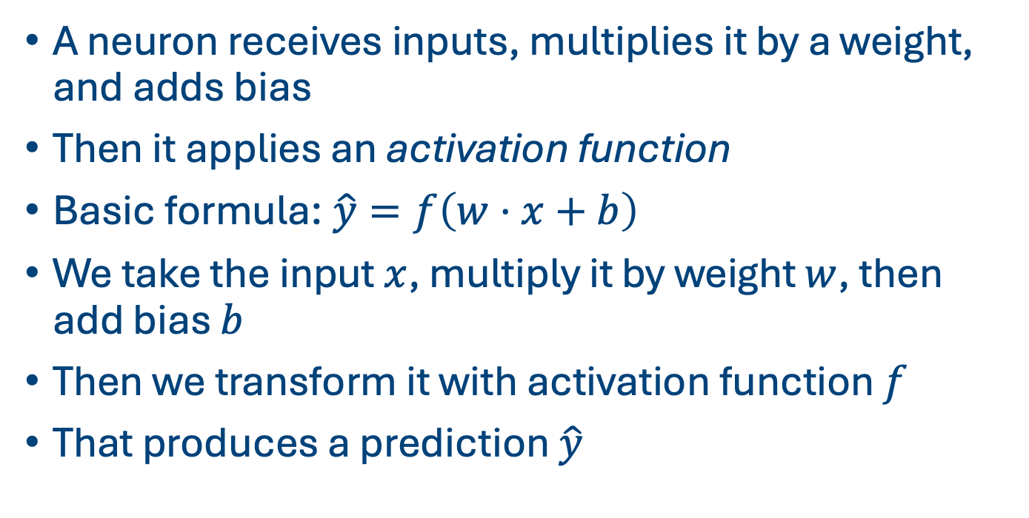
Neurons
A neuron receives inputs, multiplies it by a weight, and adds bias
Then it applies an activation function
Basic formula:$\hat{y}=f\left(w⋅x+b\right)$
We take the input $x$, multiply it by weight $w$, then add bias $b$
Then we transform it with activation function $f$
That produces a prediction $\hat{y}$

Slide 5
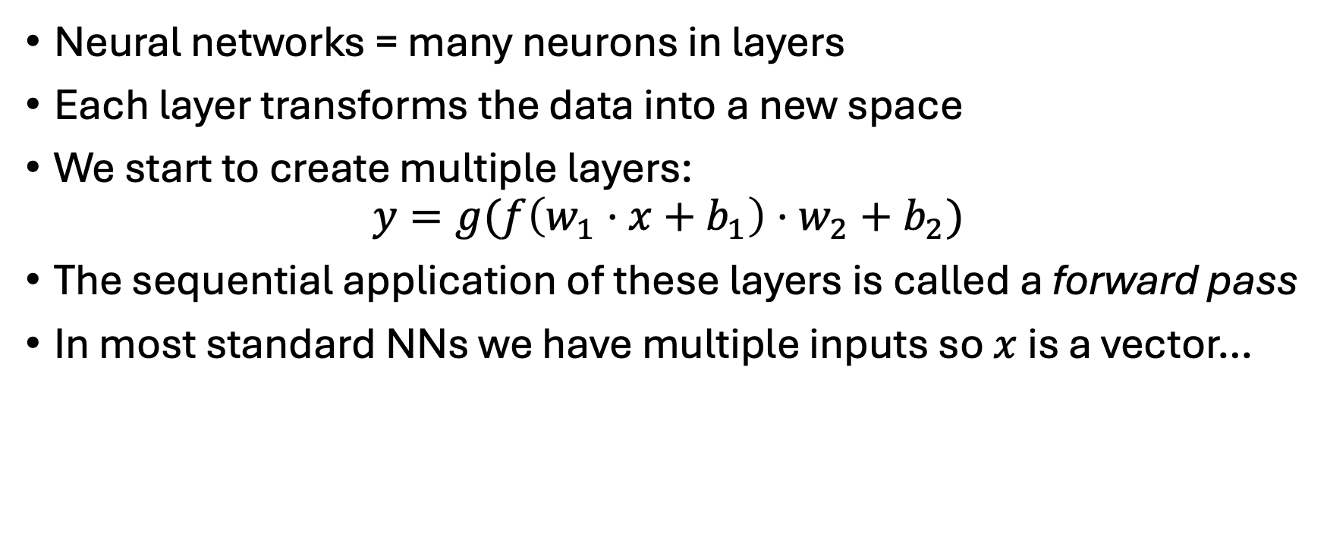
Networks as compositions
Neural networks = many neurons in layers
Each layer transforms the data into a new space
We start to create multiple layers:
$$y=g(f\left(w_{1}⋅x+b_{1}\right)⋅w_{2}+b_{2})$$
The sequential application of these layers is called a forward pass
In most standard NNs we have multiple inputs so $x$ is a vector…

Slide 6
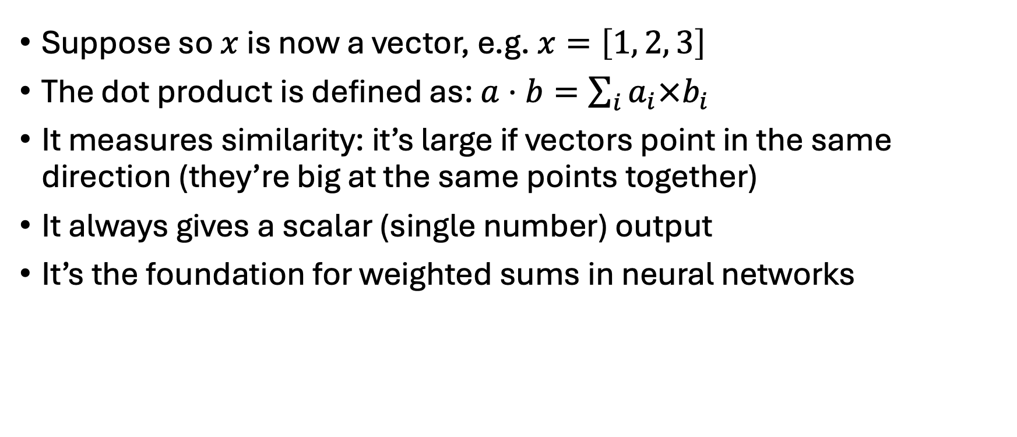
Dot Products
Suppose so $x$ is now a vector, e.g. $x=\left[1, 2, 3\right]$
The dot product is defined as: $a⋅b=\sum_{i}{a_{i}×b_{i}}$
It measures similarity: it’s large if vectors point in the same direction (they’re big at the same points together)
It always gives a scalar (single number) output
It’s the foundation for weighted sums in neural networks

Slide 7
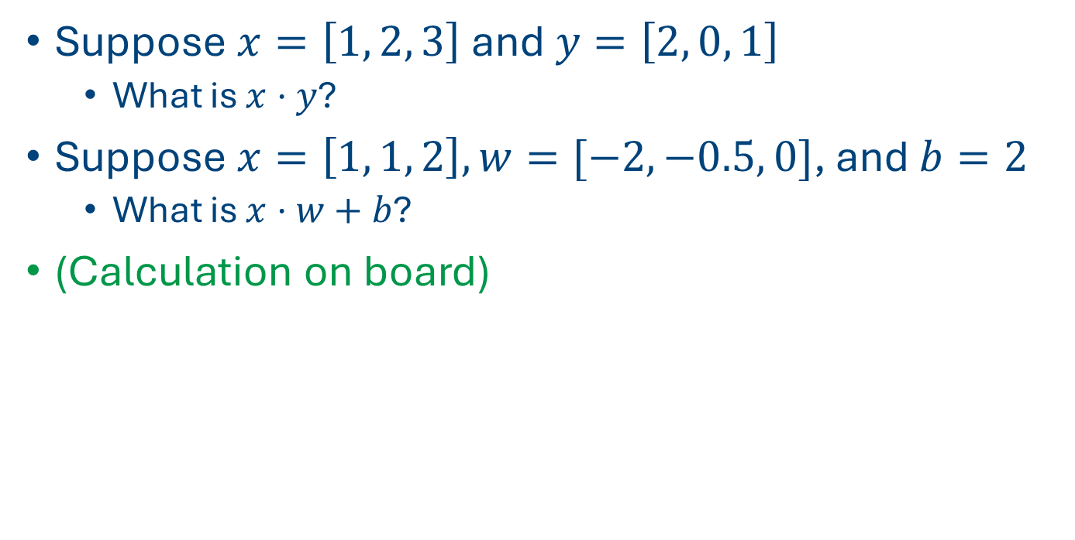
Dot product quiz
Suppose $x=\left[1, 2, 3\right]$ and$y=\left[2, 0, 1\right]$
What is $x⋅y$?
Suppose $x=\left[1, 1, 2\right], w=[−2, −0.5, 0]$, and $b=2$
What is $x⋅w+b$?
(Calculation on board)

Slide 8
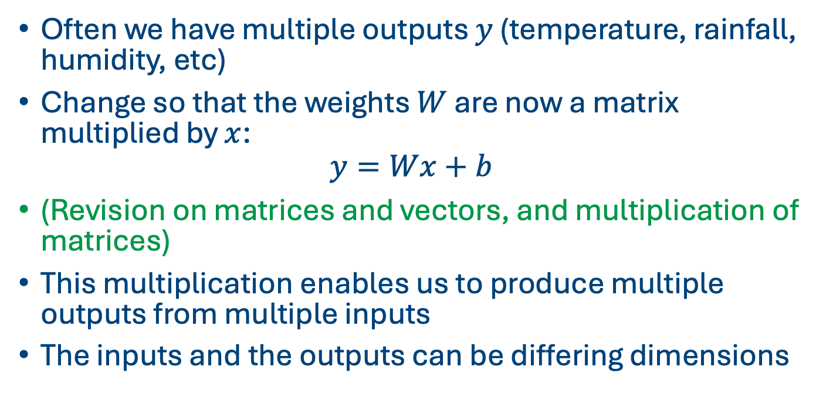
Multiple outputs
Often we have multiple outputs $y$ (temperature, rainfall, humidity, etc)
Change so that the weights $W$ are now a matrix multiplied by $x$:
$$y=Wx+b$$
(Revision on matrices and vectors, and multiplication of matrices)
This multiplication enables us to produce multiple outputs from multiple inputs
The inputs and the outputs can be differing dimensions

Slide 9
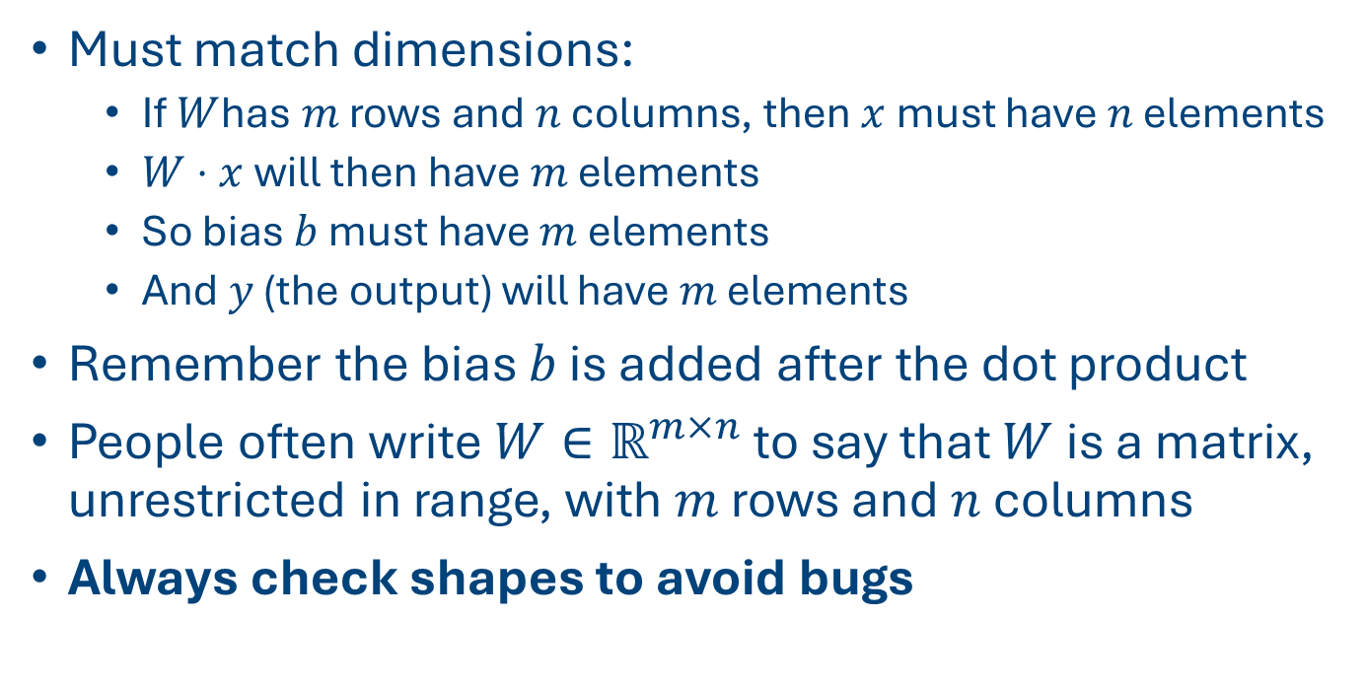
Matrix Shapes and Rules
Must match dimensions:
If $W$has $m$ rows and $n$ columns, then $x$ must have $n$ elements
$W⋅x$ will then have $m$ elements
So bias $b$ must have $m$ elements
And $y$ (the output) will have $m$ elements
Remember the bias $b$ is added after the dot product
People often write $W∈ℝ^{m×n}$ to say that $W$ is a matrix, unrestricted in range, with $m$ rows and $n$ columns
Always check shapes to avoid bugs

Slide 10
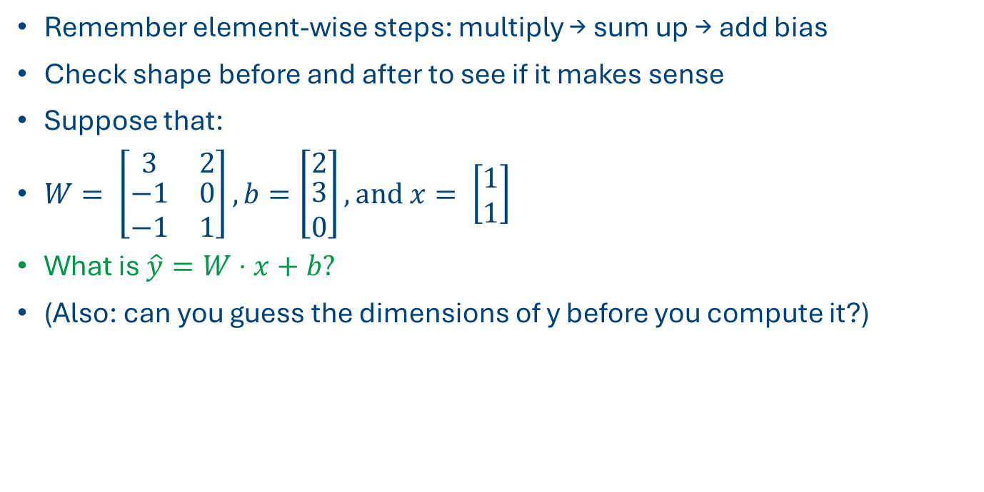
Hands-On: Linear Layer Example
Remember element-wise steps: multiply → sum up → add bias
Check shape before and after to see if it makes sense
Suppose that:
$W= \left[\begin{matrix}3 & 2 \\ \begin{aligned}−1 \\ −1\end{aligned} & \begin{aligned}0 \\ 1\end{aligned}\end{matrix}\right], b=\left[\begin{matrix}2 \\ \begin{aligned}3 \\ 0\end{aligned}\end{matrix}\right], and x= \left[\begin{matrix}1 \\ 1\end{matrix}\right]$
What is $\hat{y}=W⋅x+b?$
(Also: can you guess the dimensions of y before you compute it?)

Slide 11
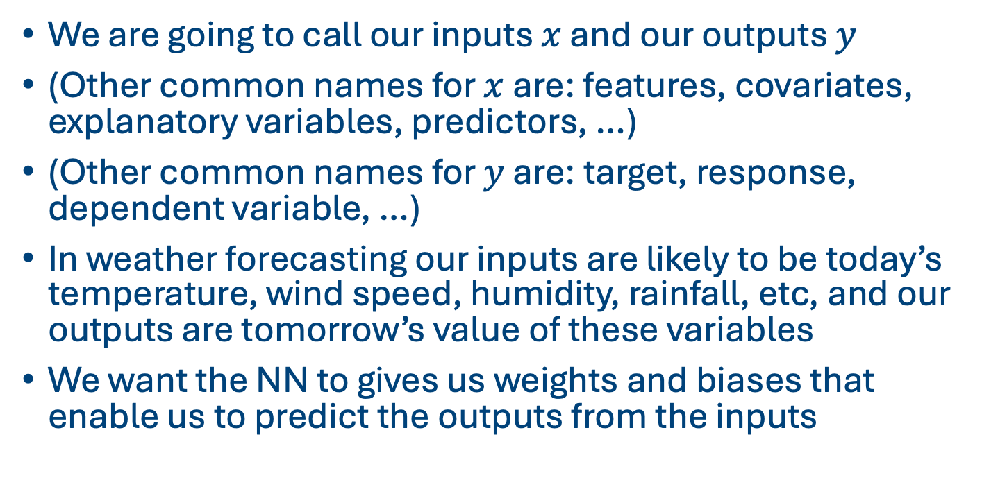
How does this link to weather and climate?
We are going to call our inputs $x$ and our outputs $y$
(Other common names for $x$ are: features, covariates, explanatory variables, predictors, …)
(Other common names for $y$ are: target, response, dependent variable, …)
In weather forecasting our inputs are likely to be today’s temperature, wind speed, humidity, rainfall, etc, and our outputs are tomorrow’s value of these variables
We want the NN to gives us weights and biases that enable us to predict the outputs from the inputs

Slide 12






Drawing the network
NNs often represented in a picture that shows how the layers link together
Here’s one for the linear regression we fitted in the last class:
$$x₁$$
$$w_{1}$$
$$x₂$$
$$\hat{y}$$
$$w_{2}$$
$$b$$
1

Slide 13




Increasing the number of outputs
Now suppose we had multiple outputs:
Each line has a weight associated with it
$$x₁$$
$${\hat{y}}_{1}$$
$$x₂$$
$${\hat{y}}_{2}$$
1

Slide 14




Increasing the number of hidden layers
And now suppose we created some extra layers
Note: most graphs ignore the biases
$$x₁$$
$${\hat{h}}_{1}$$
$${\hat{y}}_{1}$$
$$x₂$$
$${\hat{h}}_{2}$$
$${\hat{y}}_{2}$$
1
1

Slide 15
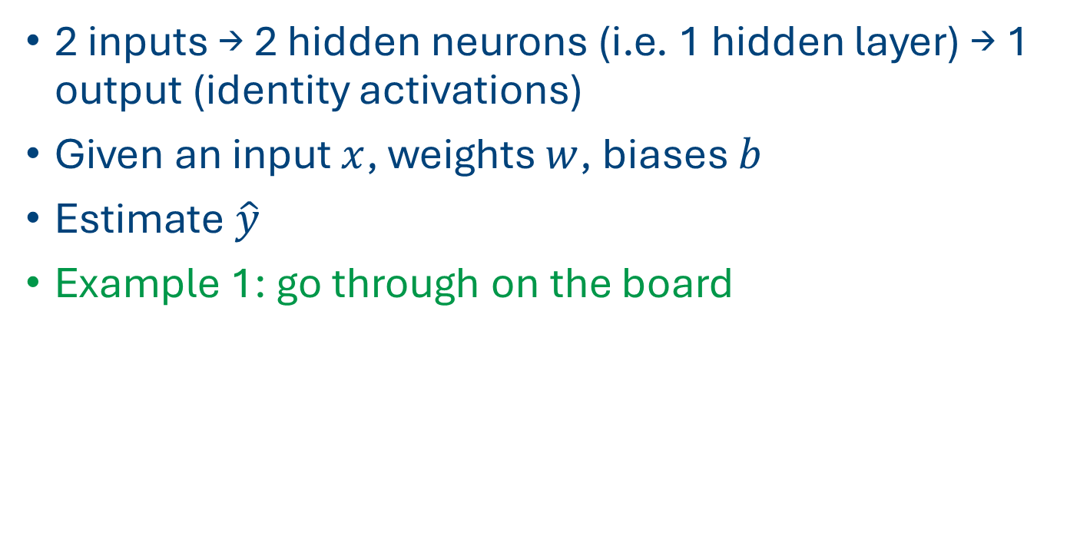
Example forward pass
2 inputs → 2 hidden neurons (i.e. 1 hidden layer) → 1 output (identity activations)
Given an input $x$, weights $w$, biases $b$
Estimate $\hat{y}$
Example 1: go through on the board

Slide 16
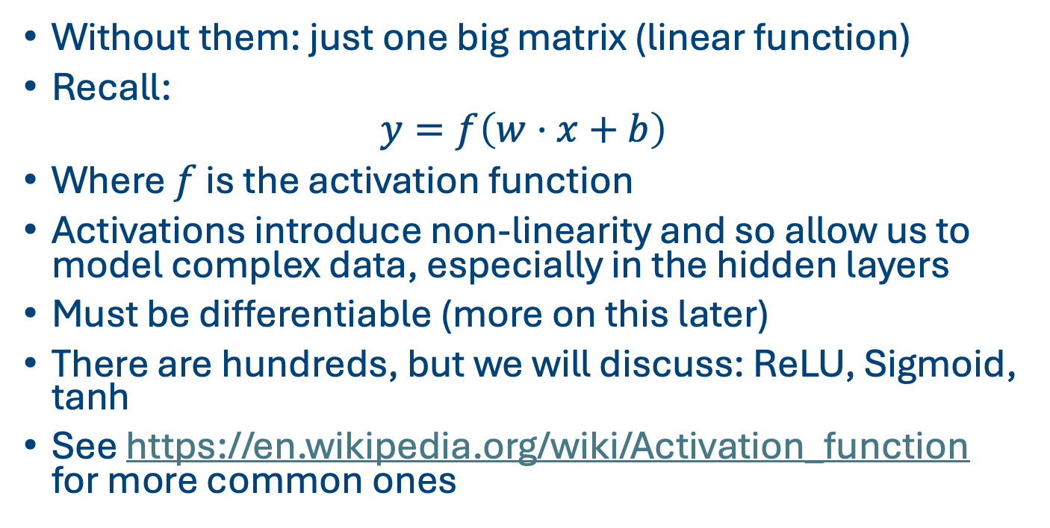
Activation functions
Without them: just one big matrix (linear function)
Recall:
$$y=f\left(w⋅x+b\right)$$
Where $f$ is the activation function
Activations introduce non-linearity and so allow us to model complex data, especially in the hidden layers
Must be differentiable (more on this later)
There are hundreds, but we will discuss: ReLU, Sigmoid, tanh
See https://en.wikipedia.org/wiki/Activation_function for more common ones

Slide 17
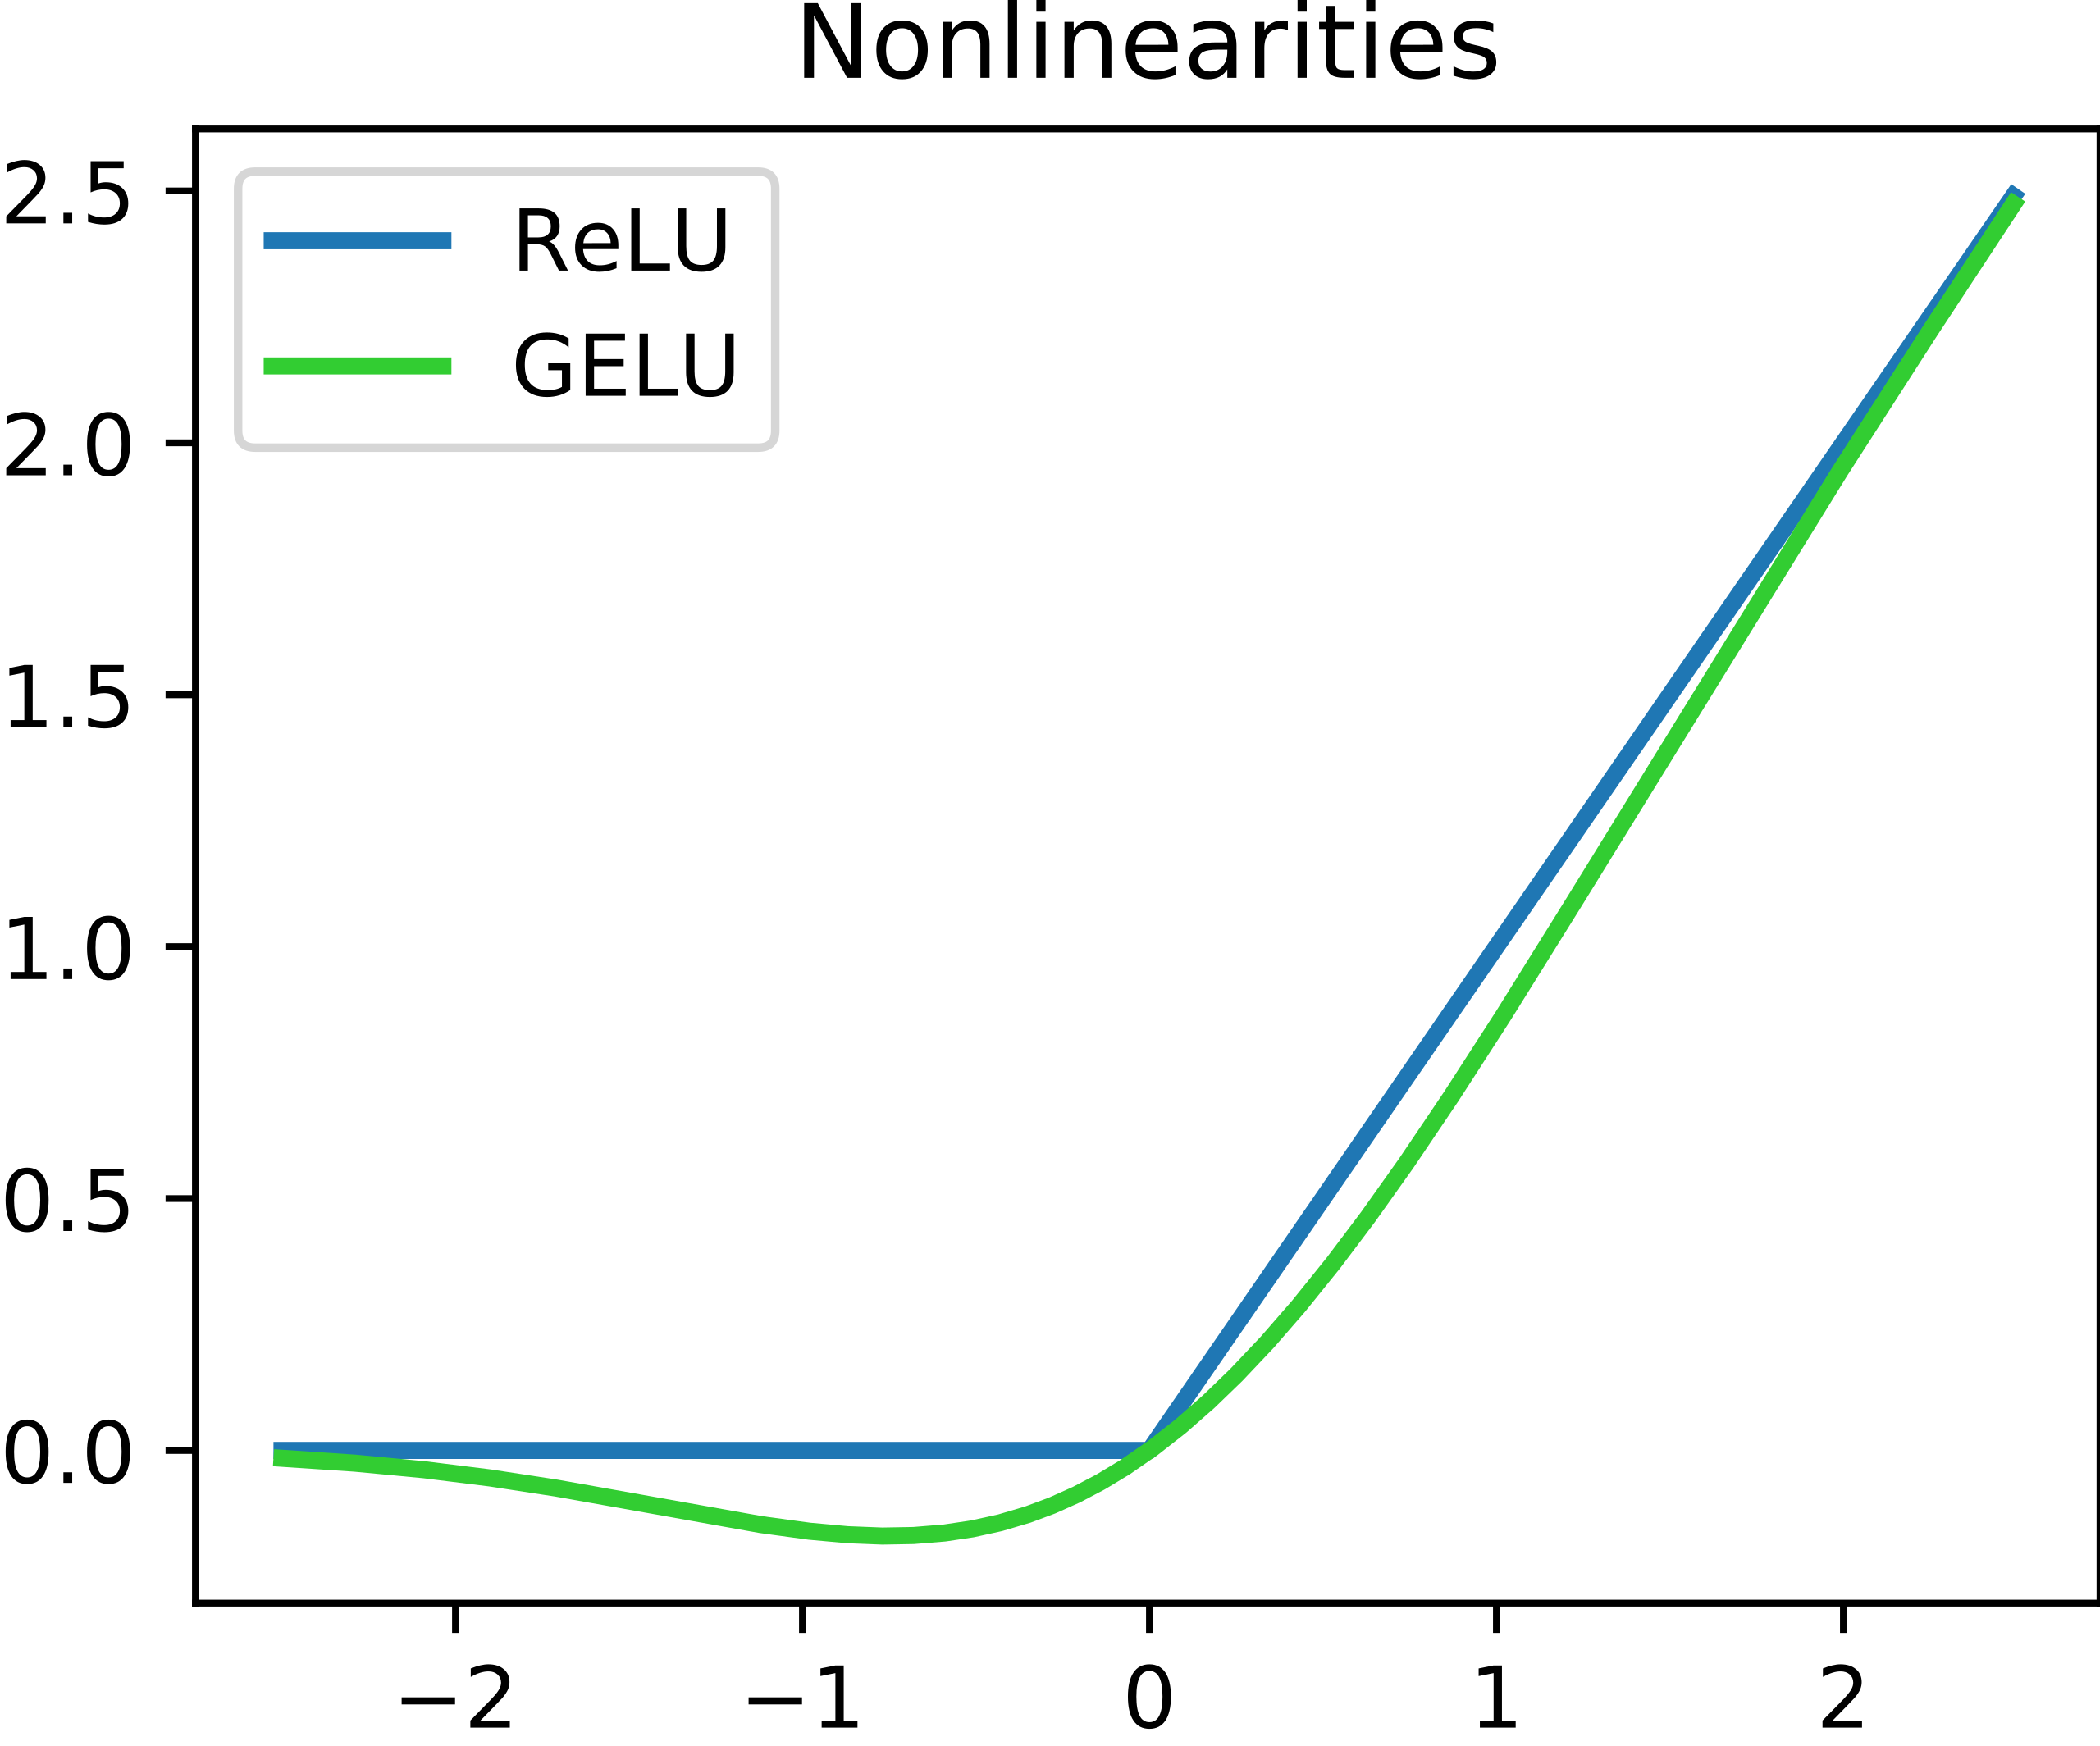
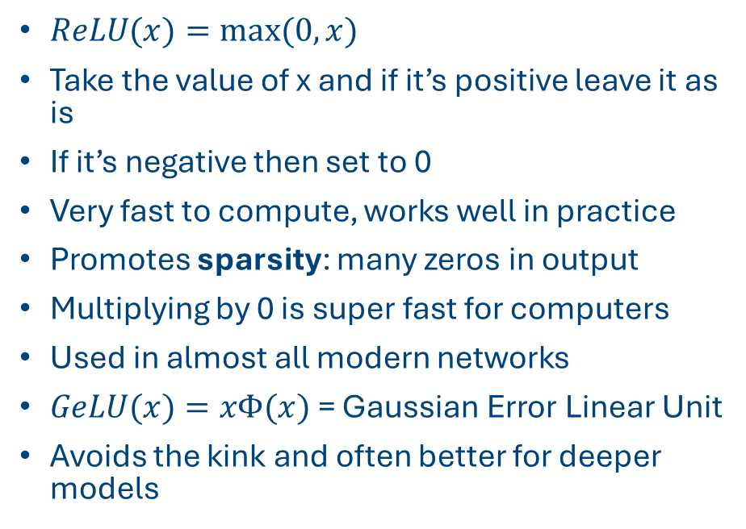
ReLU – Rectified Linear Unit
$ReLU(x)=max⁡(0,x)$
Take the value of x and if it’s positive leave it as is
If it’s negative then set to 0
Very fast to compute, works well in practice
Promotes sparsity: many zeros in output
Multiplying by 0 is super fast for computers
Used in almost all modern networks
$GeLU(x)=xΦ(x)$ = Gaussian Error Linear Unit
Avoids the kink and often better for deeper models
From https://en.wikipedia.org/wiki/Rectifier_(neural_networks)

Slide 18
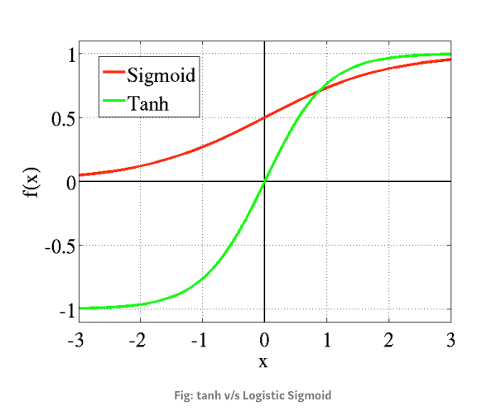
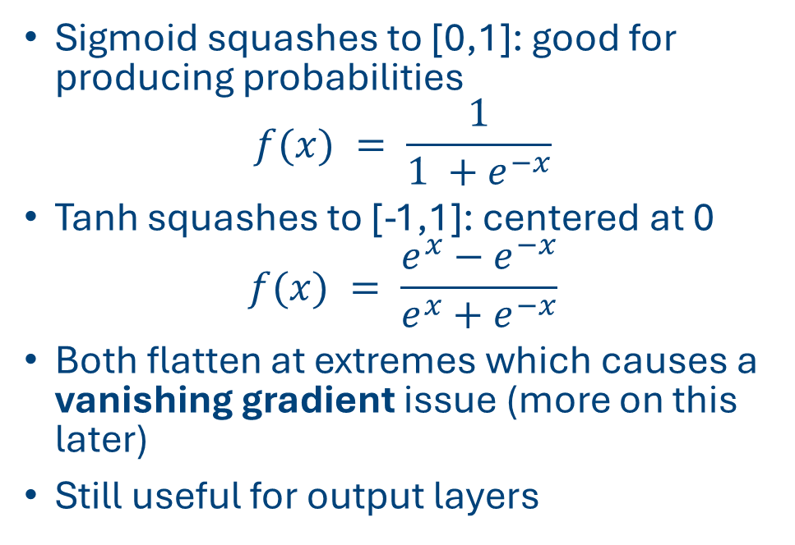
Sigmoid and tanh
Sigmoid squashes to [0,1]: good for producing probabilities
$$f(x) = \frac{1}{1 +e^{−x}}$$
Tanh squashes to [-1,1]: centered at 0
$$f(x) = \frac{e^{x}−e^{−x}}{e^{x}+e^{−x}}$$
Both flatten at extremes which causes a vanishing gradient issue (more on this later)
Still useful for output layers
From https://miro.medium.com/v2/resize:fit:1280/1*R2e5_A-hD3VB3B1wv3qaQA.png

Slide 19
Activation Practice
(Example 2 on board)
2 inputs → 2 hidden layers with ReLU → 2 outputs
Same process, one extra step: input, weight, bias → compute pre-activation → apply function
Could also apply sigmoid or tanh activation functions
What differences do you observe?

Slide 20

Building a simple network
Input: 2-d vector $x$
Linear transform: $W$, $b$
ReLU activation
Output: 2-d hidden representation

Slide 21
Quiz Time – Check Your Understanding
Exercise: how many weights in a neural net with 4 inputs, 1 output and 3 hidden neurons across each of 2 hidden layers?

Slide 22
Common pitfalls
Forgetting bias
Confusing dimensions
Applying wrong (or inappropriate) activation function
Bad learning rates
Check, check, and check again (and use LLMs to help)

Slide 23
A neural network for weather data
Inputs = today’s temperature, humidity, wind speed...
Outputs = tomorrow’s temperature, humidity, wind speed
NNs can learn the spatial and temporal patterns
Next lecture: discover how NNs learn the weights and the biases from data
In real-world NNs there are many neurons at different layers of the architecture. Each has its own weights and biases

Slide 24
Next class: training
So far: forward pass only. i.e. taking weights and biases, and getting to the outputs
Next: how do we learn weights?
Concepts of loss, gradients, updates

Slide 25
Summary
A neural network is just a fancy linear regression with extra hidden nodes
These hidden nodes can capture much more flexible behaviour than the basic LR
Most of the (forward) calculations are just matrix multiplication of weights and biases
We use activation functions to allow more flexibility (and especially sparsity) in the way the values are modelled
Tomorrow: how do we estimate the weights?

Slide 26
Next class (if time)
Run through D1C3_code.ipynb

Slide 27
Afternoon session instructions
Go and read in detail one of the following three papers:
Graphcast
Aardvark
AIFS
Prepare a short (5 minute) and simple group presentation that summarises the paper. All members of group must present.
Make sure your computer is set up to run Linux (Ubuntu) and PyTorch

